Slide 1
People Counter using Thermal Tripwire Sensor
Team 8: Janis Intoy and Emily Lam
May 3rd, 2017

Slide 2


Problem Statement
Thermal Camera
The efficiency of HVAC (Heating Ventilation & Air Conditioning) systems can be improved by making them adaptive to the number of people in a room.
In order to estimate a room’s occupancy level, the Occusense Senior Design team has created a thermal sensor system to capture the motion of people through doorways.
We develop a real- time algorithm to detect the direction of motion of people passing through in order to continuously track the number of people in the room.
Person Enter?
Person Exit?
Room Occupancy
Heating
Ventilation
Cooling
Notes:
JANIS

Slide 3
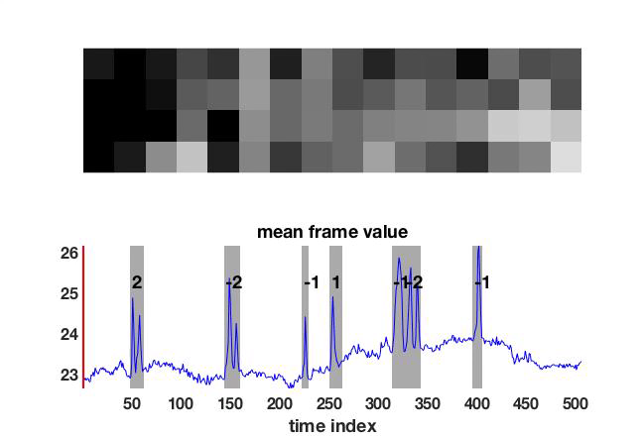
Assumptions and Constraints
Low frame rate (8-12 Hz) and low resolution 16x4 array thermal sensor
Low number of entry points
Tripwire methodology
Background has slow temporal dynamics
Data starts with some number of background-only frames
Only vertical direction matters
IN
OUT
Notes:
JANIS

Slide 4
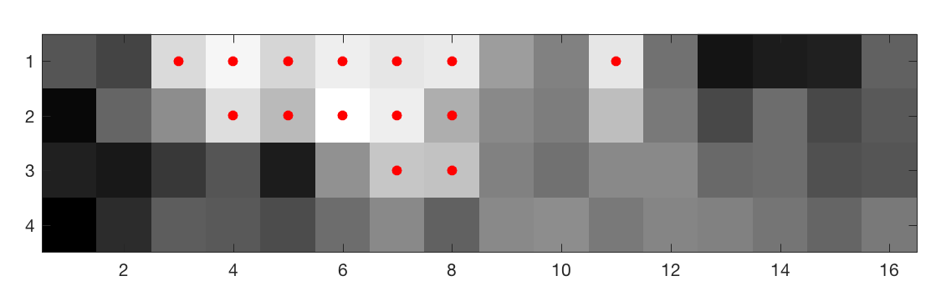
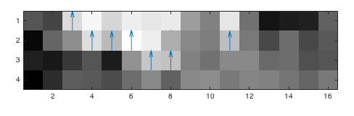
Implementation: Three-step Approach
1. Detect a person in the doorway
Background Subtraction
Algorithm
Foreground Mask
Data
2. Determine direction person is moving
Optical Flow
Algorithm
Spatial Gradients
3. Keep track of occupancy
Foreground Mask
Classifier
People Count
Spatial Gradients Quiver
Notes:
EMILY

Slide 5
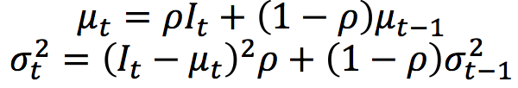
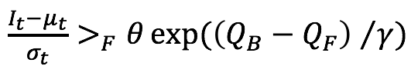
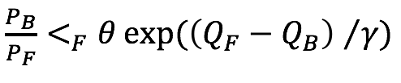
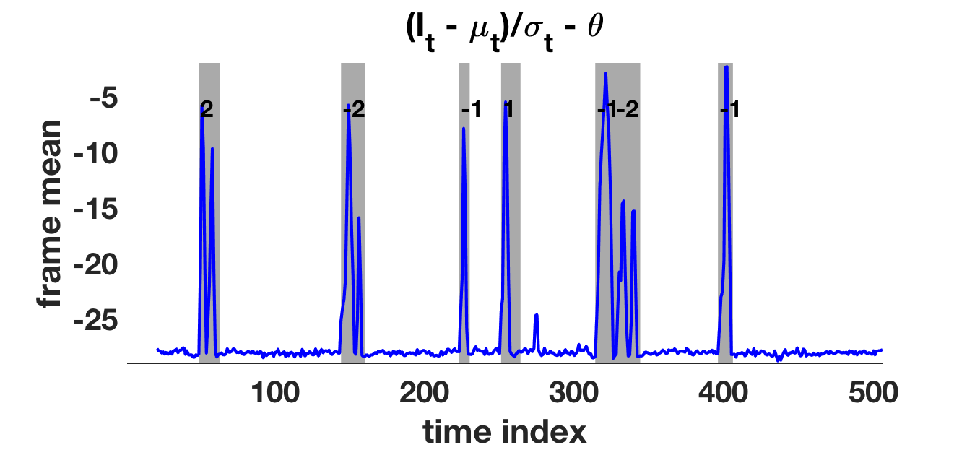
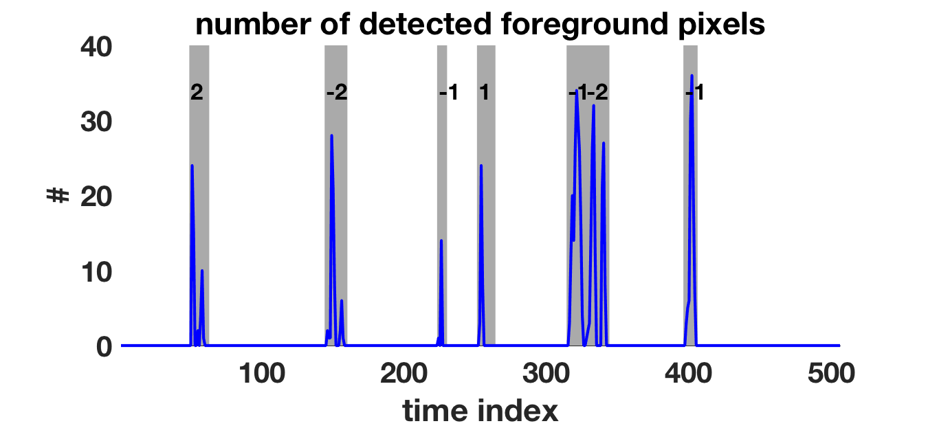
Background Subtraction
Running Gaussian average
(with adaptive threshold)
background at each pixel
Foreground-adaptive
(McHugh et al., 2009)
Kernel density estimation of background and foreground models
Notes:
JANIS

Slide 6
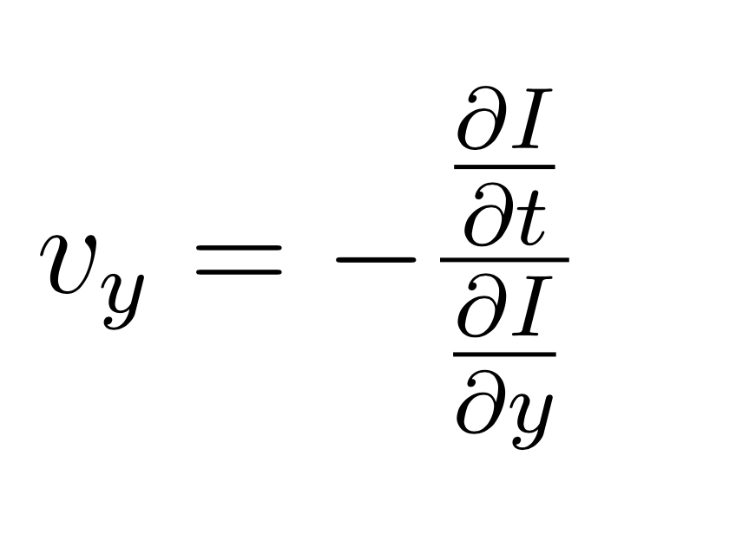
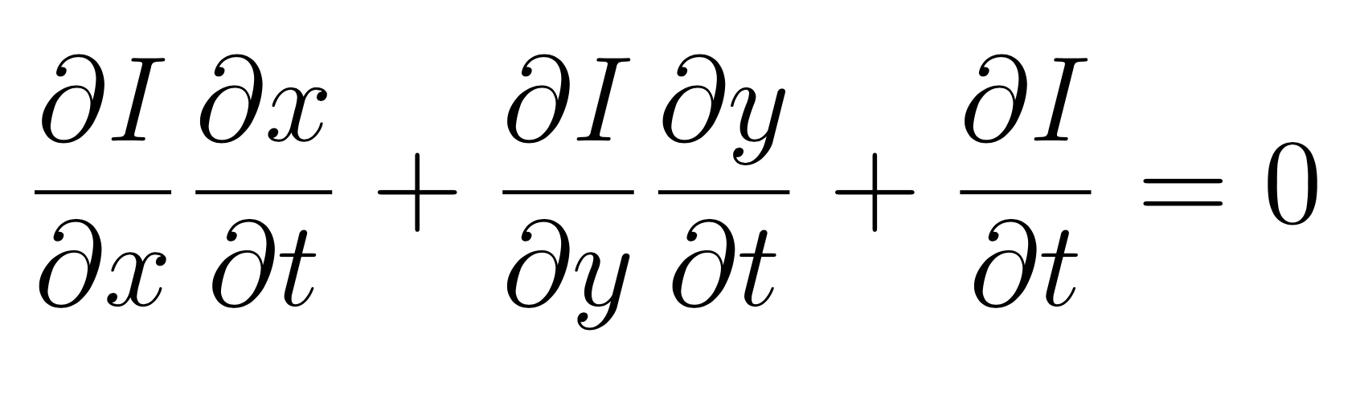
Optical Flow
Gradient-based optical flow
Velocity can be modeled using spatially and temporal gradients
Only vertical changes matter
A large v_{y} would correspond to a lot of motion in that direction
Due to boundary conditions, there are only 3x16 gradients
Direction Classifier
An event is defined as consecutive frames when motion is detected
Spatial gradients are row-averaged and column averaged per a frame
Direction is computed based on the first and last frame of an event, comparing the gradients to obtain a direction
Dynamic parameters for corner cases
Notes:
EMILY

Slide 7
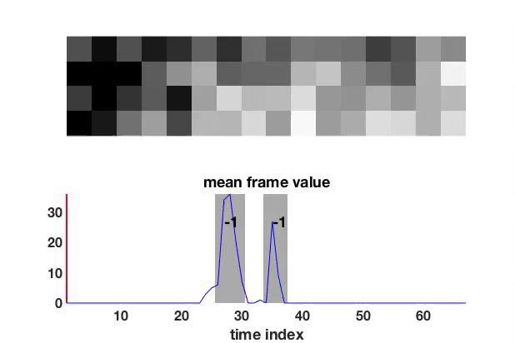
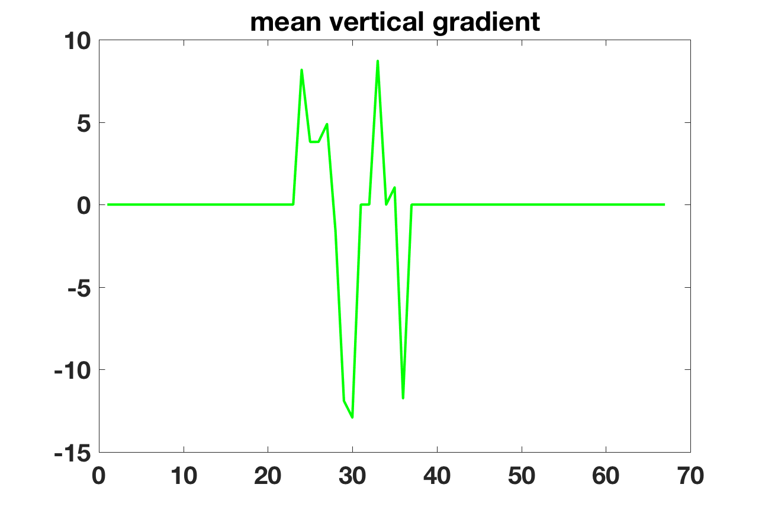
Example: Walking out
Notes:
JANIS

Slide 8
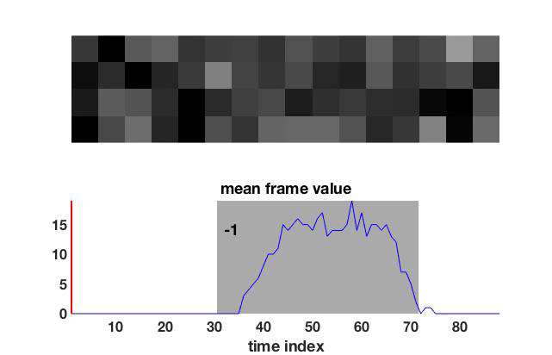
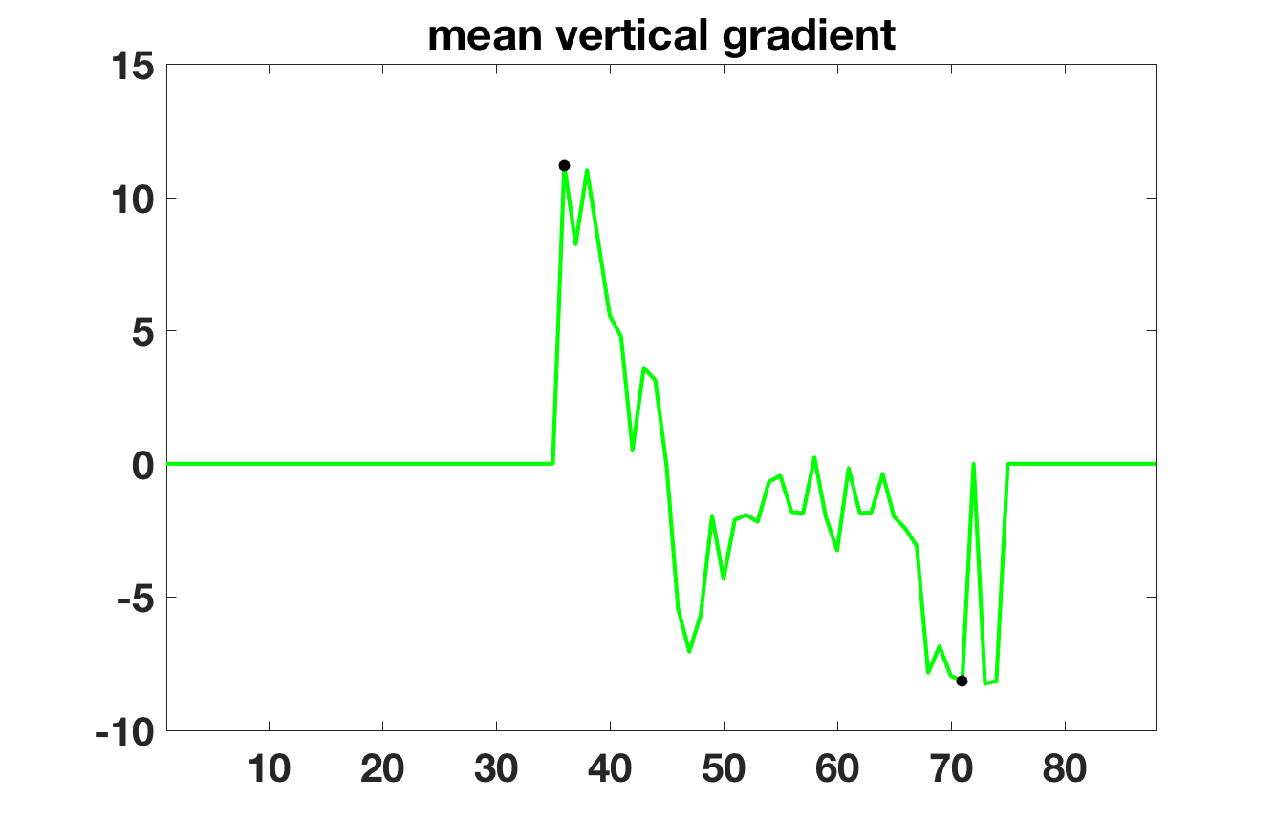
Example: Lingering by the door
Notes:
JANIS

Slide 9
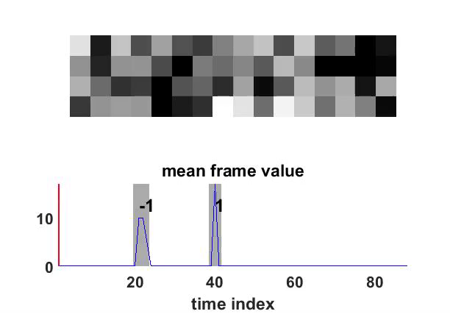
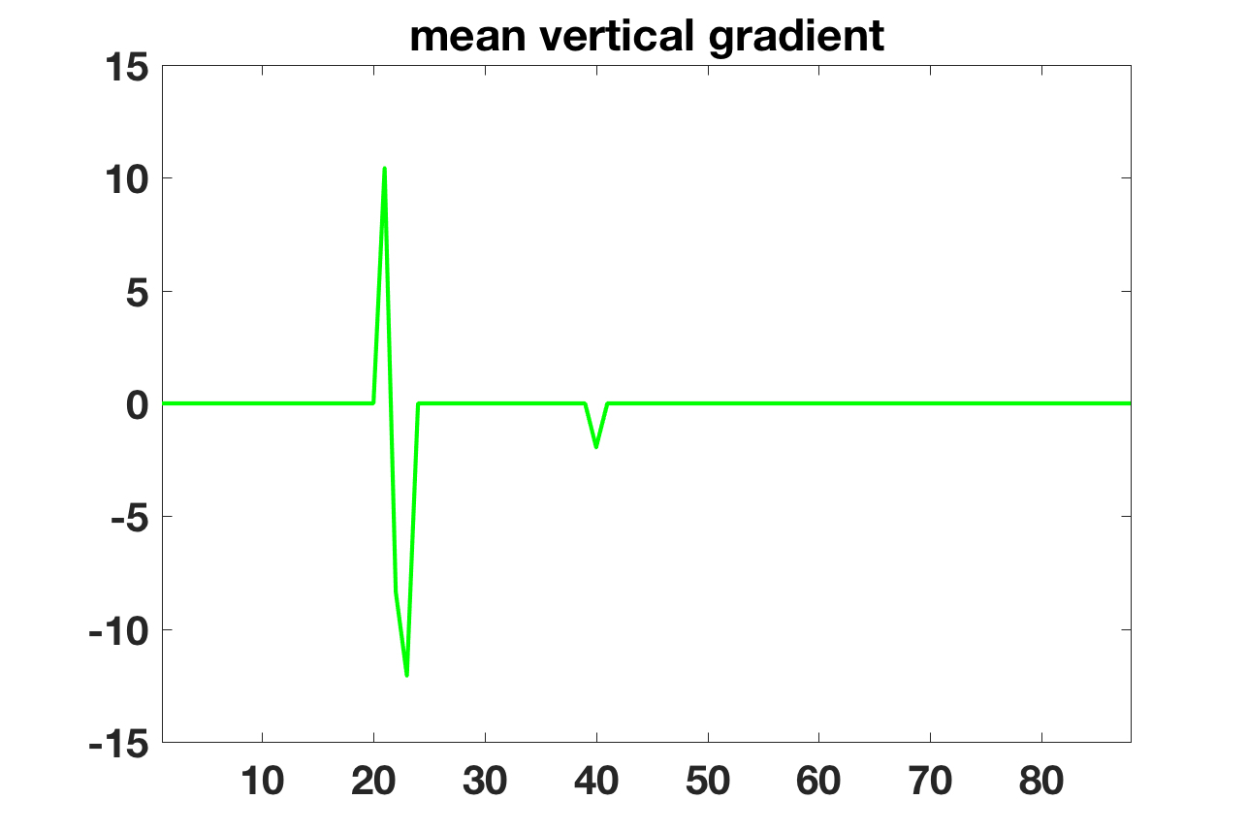
Example: Person running through door
Notes:
EMILY

Slide 10
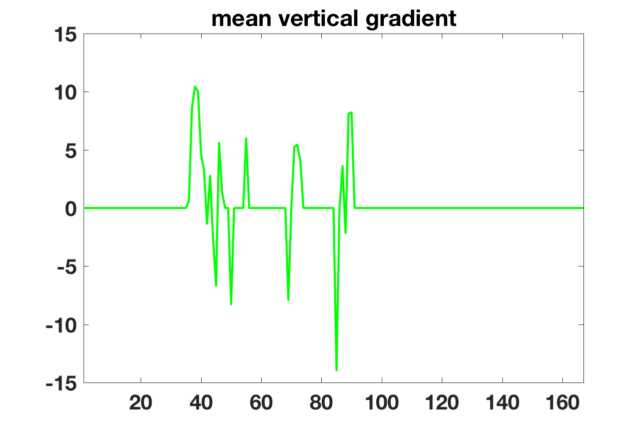
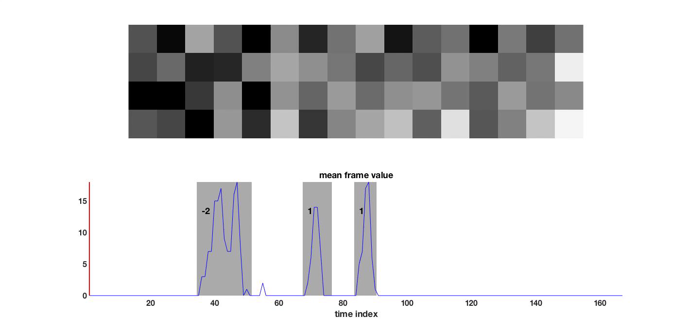
Example: Multiple people together
Notes:
EMILY

Slide 11
Example: Multiple people together
Notes:
EMILY

Slide 12
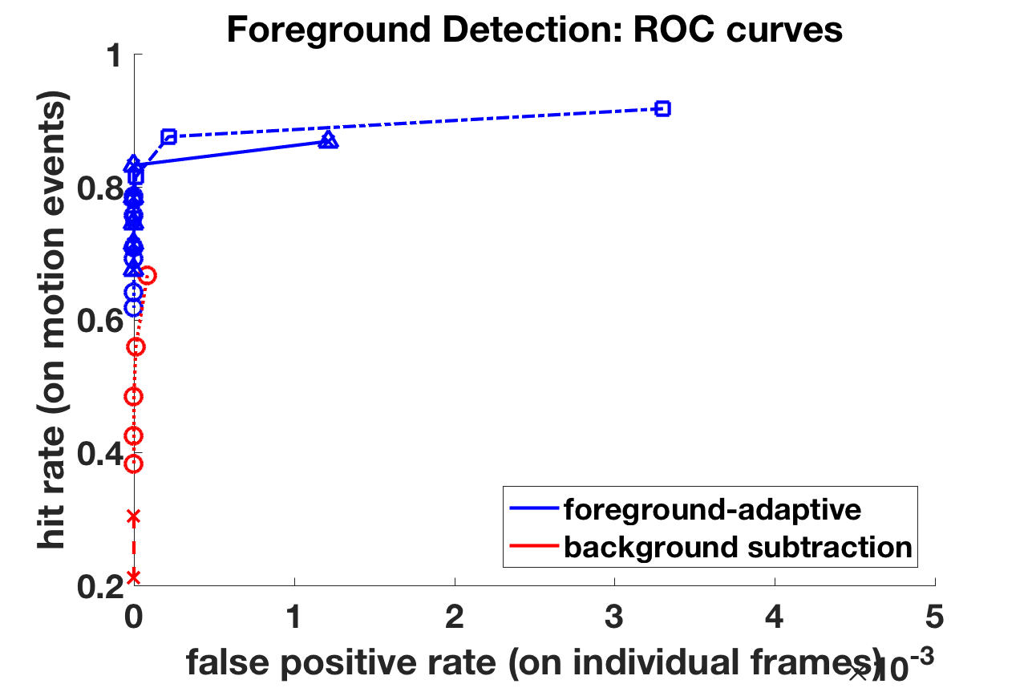
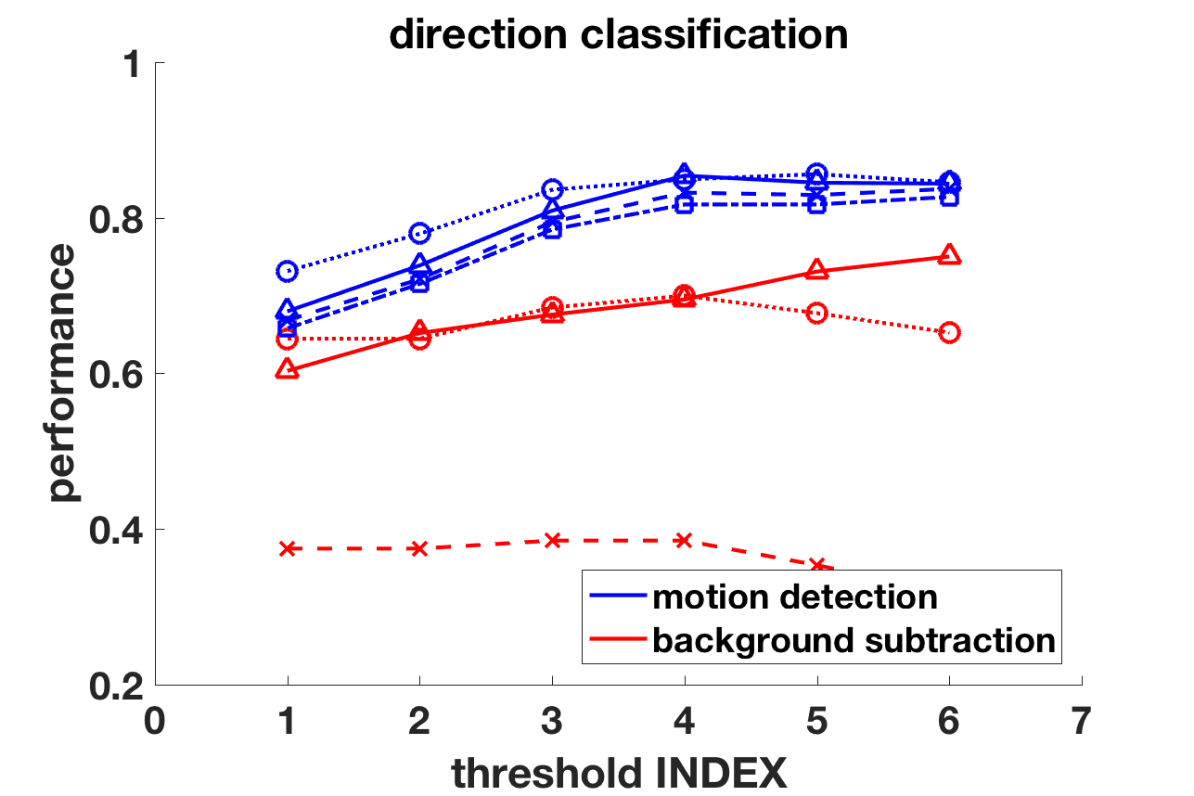
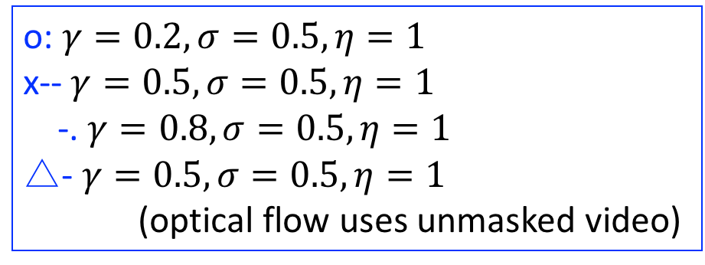
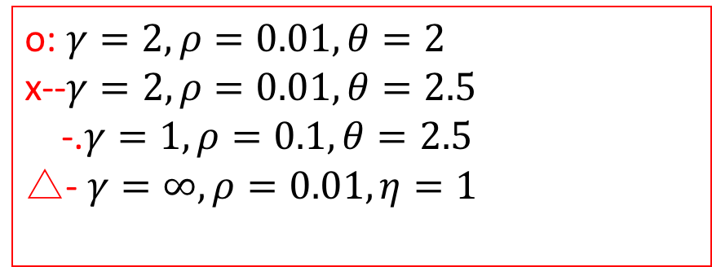
Intermediate Results
o: $γ=0.2, σ=0.5, η=1$
x-- $γ=0.5, σ=0.5, η=1$
-. $γ=0.8, σ=0.5, η=1$
△- $γ=0.5, σ=0.5, η=1$
(optical flow uses unmasked video)
o: $γ=2,ρ=0.01, θ=2$
x--$γ=2,ρ=0.01, θ=2.5$
-.$γ=1,ρ=0.1, θ=2.5$
△- $γ=∞, ρ=0.01, η=1$
Notes:
JANIS

Slide 13
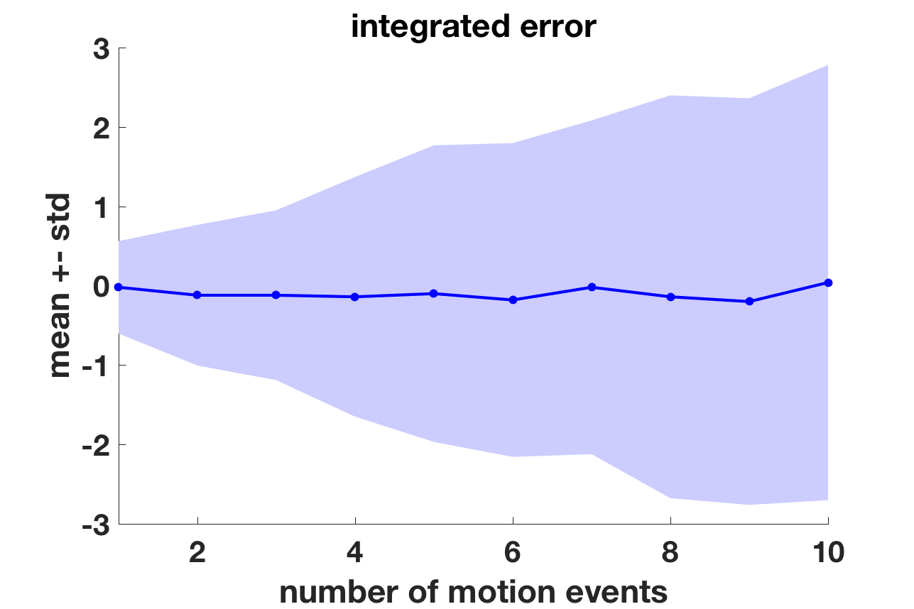
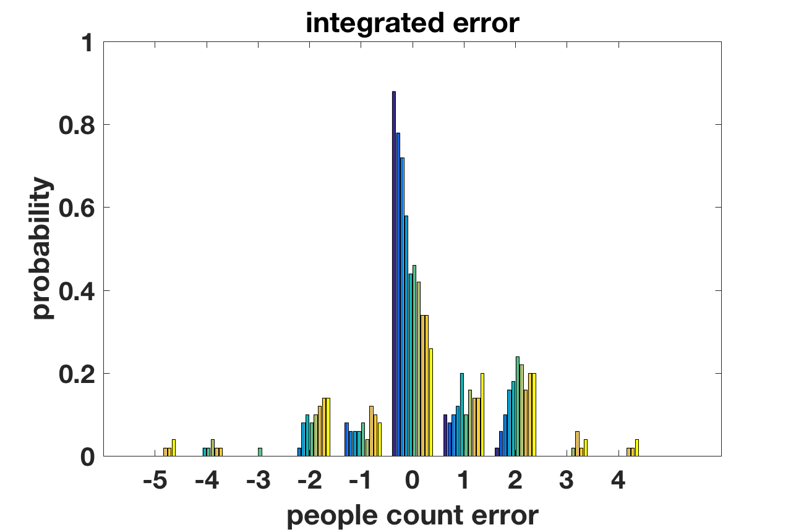
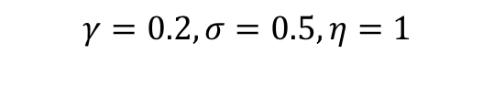
Final Results: People Count
$$γ=0.2, σ=0.5, η=1$$
Notes:
JANIS

Slide 14
Conclusions and Future Work
90% accuracy
Known issues:
Foreground identification fails to detect person
People walking in together
Challenges
Optical flow with too much temporal changes in the middle frames of an event
Distinguishing noise versus fast motion in single frame events
Mean thresholding for determining the start and stop of events
Future Work
Real-time demo
Integrate matlab with Raspberry Pi or port algorithm to Python
Notes:
EMILY

Slide 15
Questions?

Slide 16
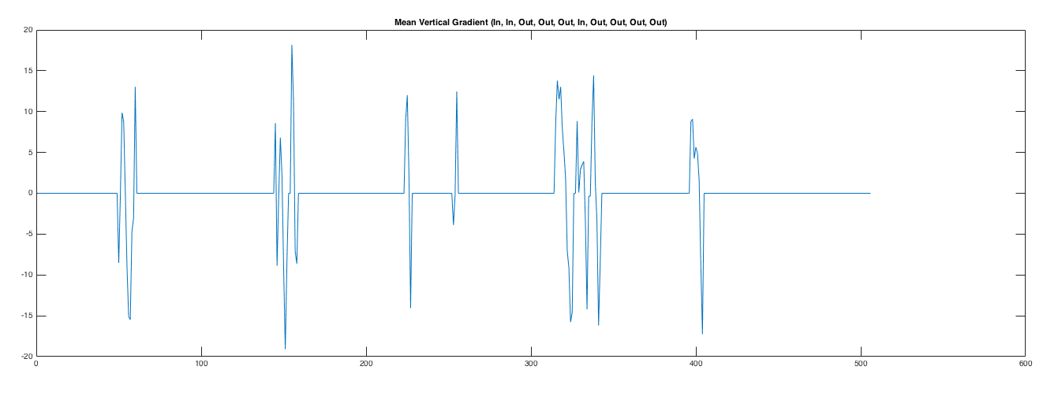
Example:

